Slide 1
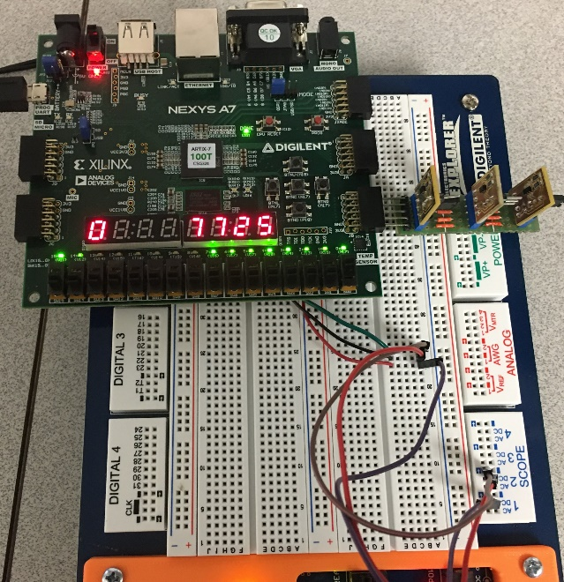
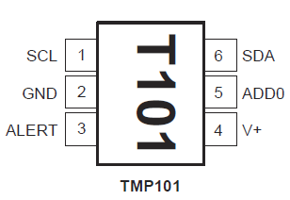

Lecture 3-2 Lab #2 Phase 2: Reading TMP101 & UART
Lab #2 Part 2 Demonstration
TMP101 Breakout boards and Addresses
TMP101 Temperature Sensor from TI
Example TMP101 I2C Bus Signals
Three TMP101 Boards on JD connector on Zybo
Lab #2 Phase II Circuit Design and Implementation
Design Ideas and Divide and Conquer
ASM Charts: Controller, Counter, Delay Timer
SCL One Shots, Count update, ACK Bit
Controller Simulation
ReadTMP101summer2021
Temperature Conversion Circuits
UART module and Distributed RAM

Slide 2
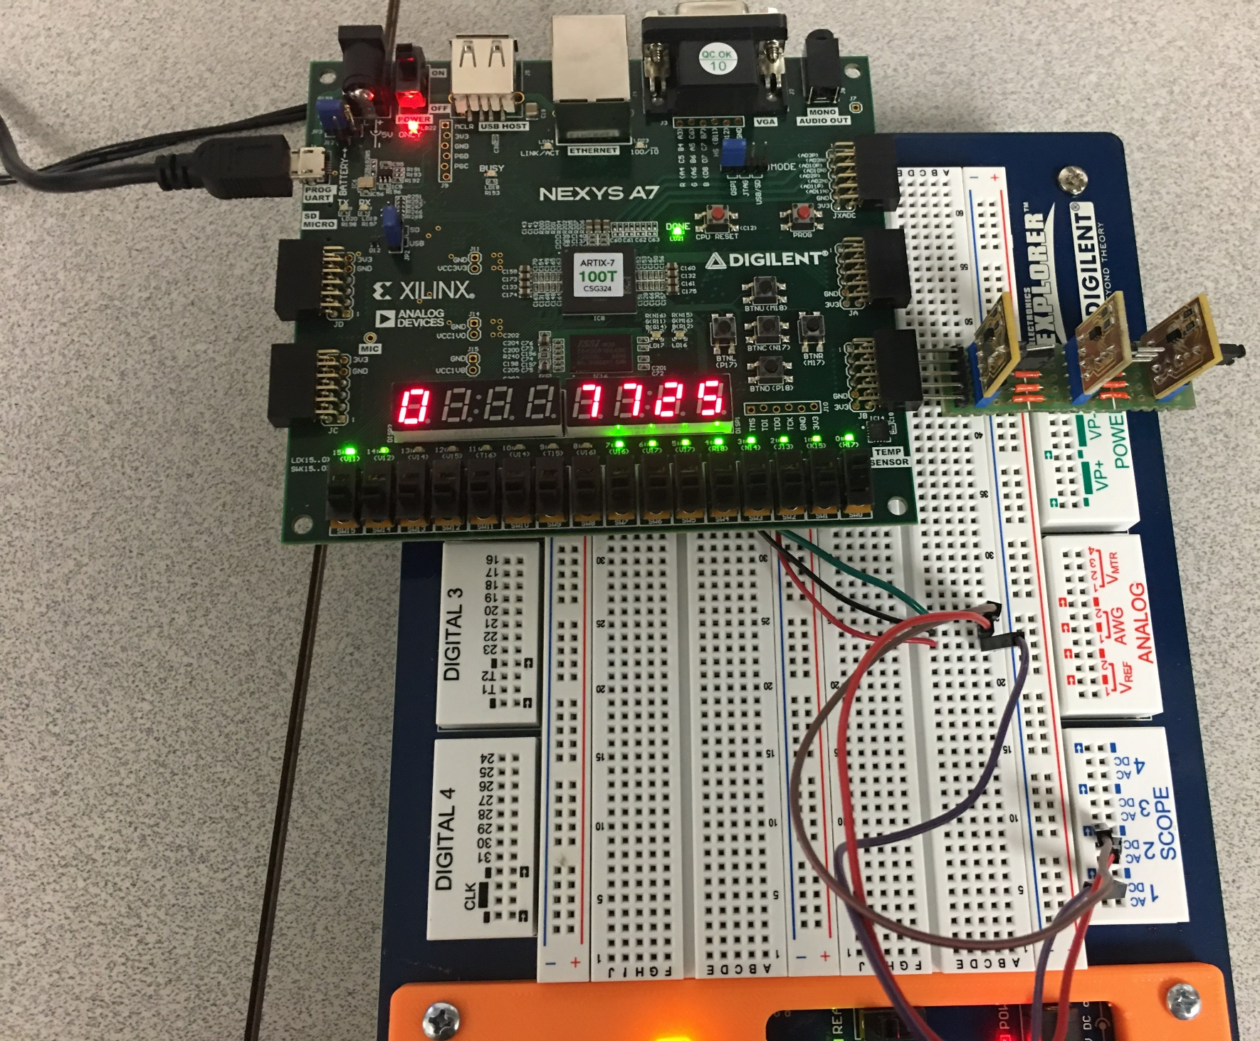
Nexys A7, TMP101 Breakout and Electronic Explorer Board as Oscilloscope
Mode=1 for continuous reading and displaying mode
Address can be changed on the fly

Slide 3
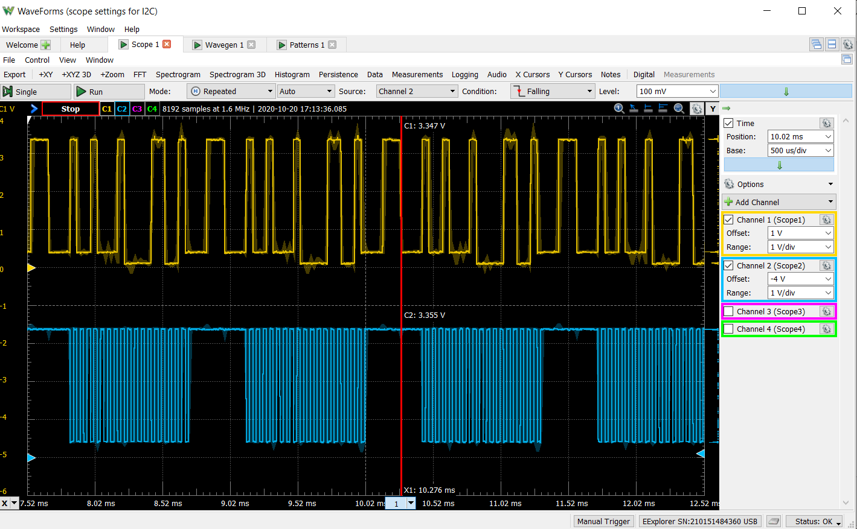
Reading a TMP101 Continuously with Waveforms from EEplorer

Slide 4
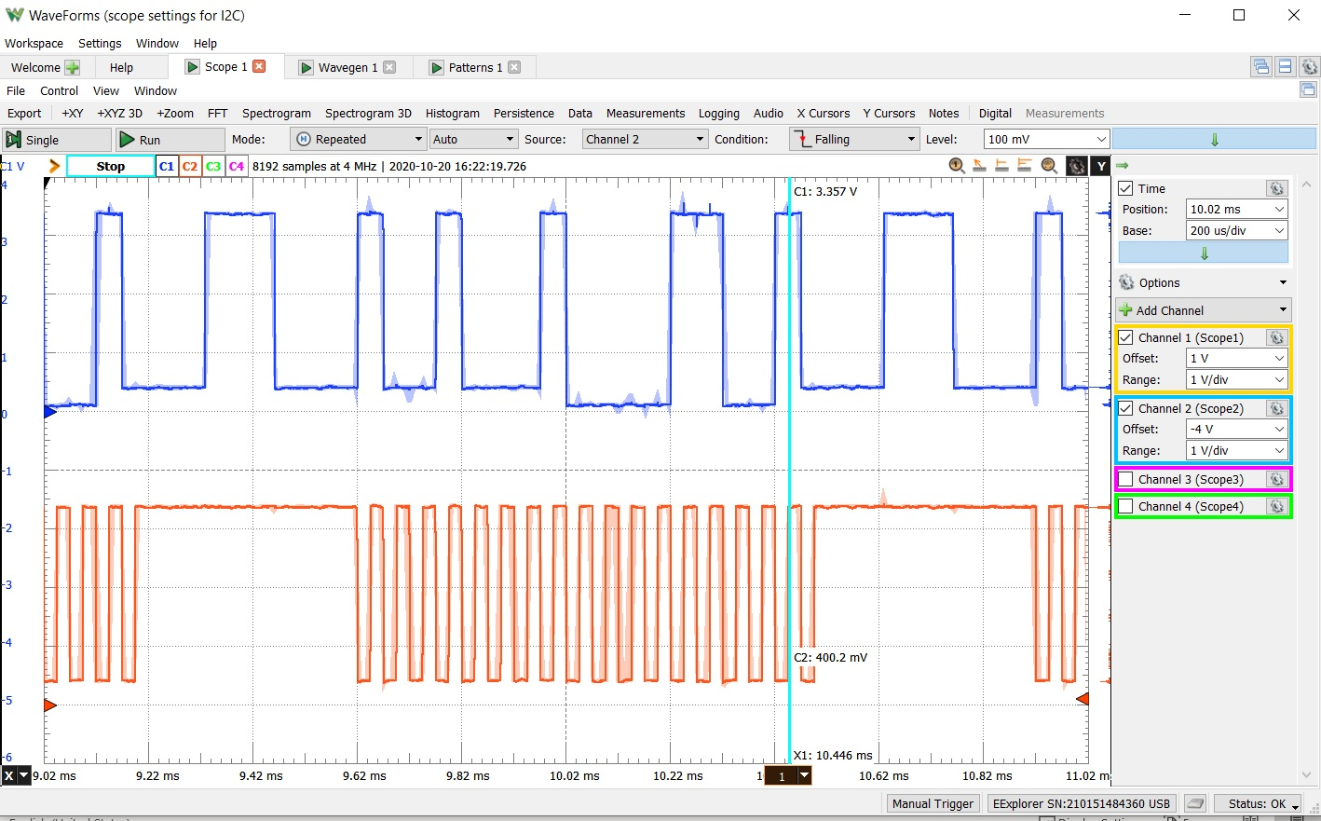
Check out One Temperature Reading
Address = 7’b1001000
Temperature 8’b00011001=25 °C

Slide 5
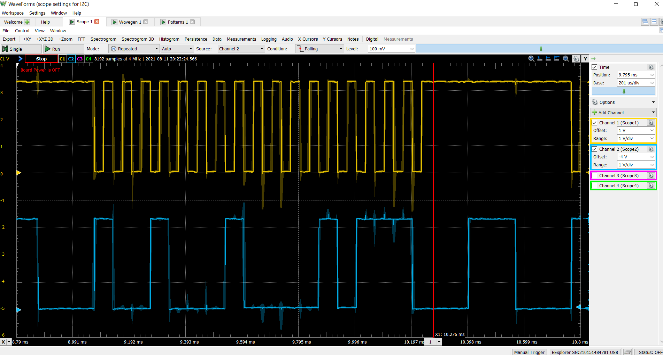

Slide 6
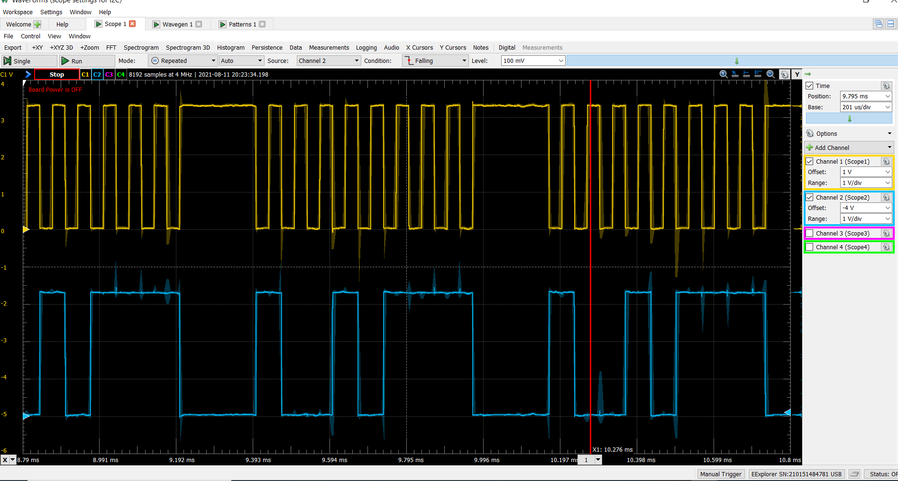

Slide 7


Slide 8
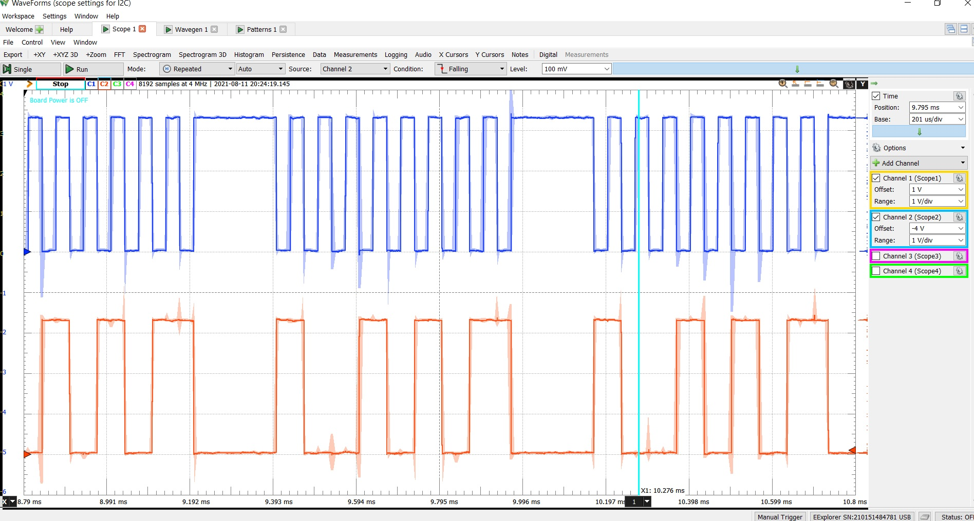

Slide 9
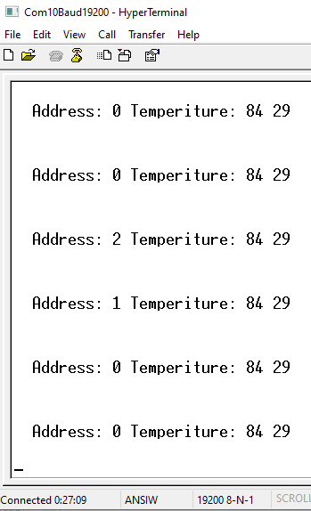
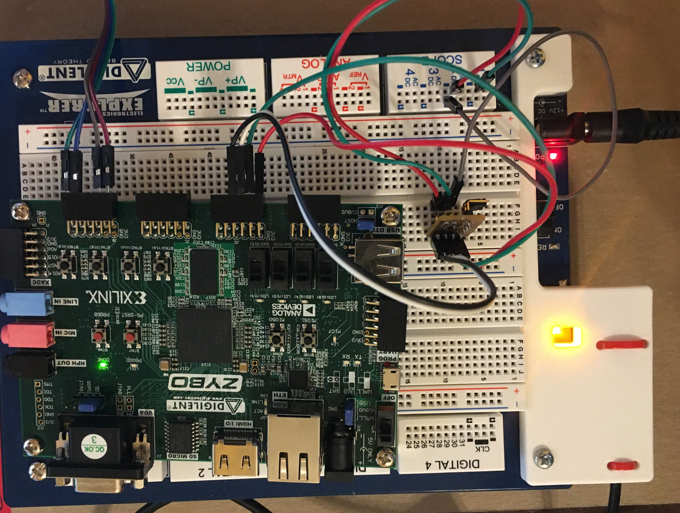
Zybo and MP101 Breakout and Electronic Explorer Board as Oscilloscope
Press Button 3 to sample once and send temperature to the serial port
Mode on SW3 is Logic 1 to sample continuously
The lower two bit address are on SW2 and SW1 to pick tmp101 at 2’b00, 2’b01 and 2’b10
Button 0 is reset button

Slide 10
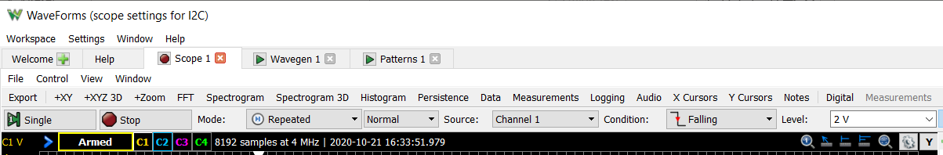
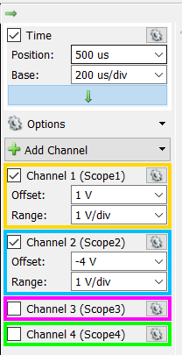
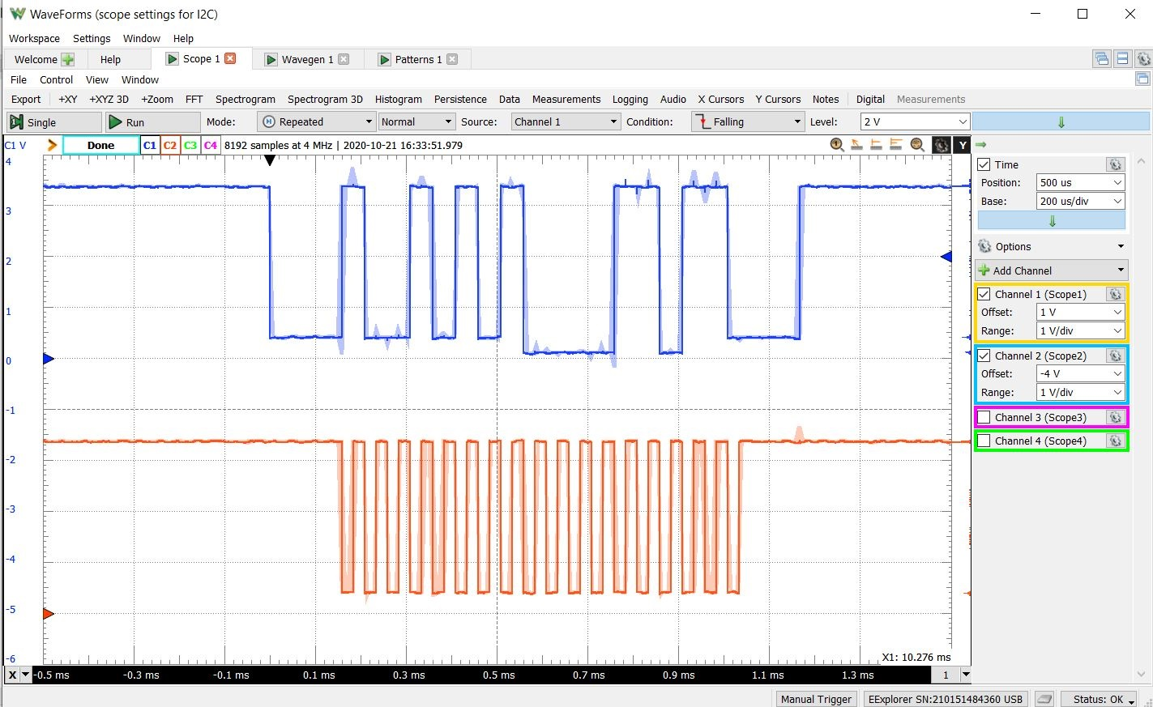
Capturing one TMP101 Value (Single-Shot) with Waveforms from EEplorer
Address = 7’b1001010 and Temperature 8’b00011011=27 °C
Press Single to get it ready (Armed) to capture falling edge on Channel 1 (SDA) at 2V level

Slide 11
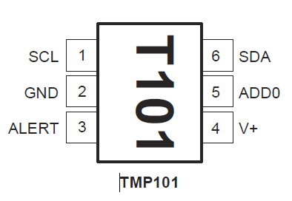
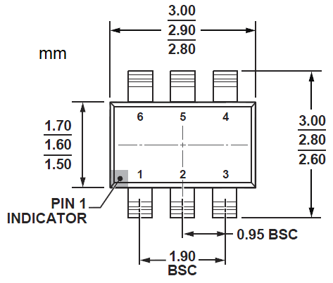
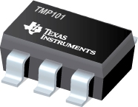
TMP101 Temperature Sensor from TI
Features
DIGITAL OUTPUT: I2C Serial 2-Wire
RESOLUTION: 9- to 12-Bits, User-Selectable
ACCURACY:
±2.0°C from −25°C to +85°C (max)
±3.0°C from −55°C to +125°C (max)
LOW QUIESCENT CURRENT:
45μA, 0.1μA Standby
WIDE SUPPLY RANGE: 2.7V to 5.5V
TINY SOT23-6 PACKAGE
Three Addresses
ADD0=0: 7’b1001000
ADD0=1: 7’b1001010
ADD0 floating: 7’b1001001
Alert Pin
One-shot conversion
Limits Status Warning
Notes:
OS/ALERT (OS)
The TMP100 and TMP101 feature a One-Shot
Temperature Measurement Mode. When the device is in
Shutdown Mode, writing a 1 to the OS/ALERT bit will start
a single temperature conversion. The device will return to
the shutdown state at the completion of the single
conversion. This is useful to reduce power consumption in
the TMP100 and TMP101 when continuous monitoring of
temperature is not required.
Reading the OS/ALERT bit will provide information about
the Comparator Mode status. The state of the POL bit will
invert the polarity of data returned from the OS/ALERT bit.
For POL = 0, the OS/ALERT will read as 1 until the
temperature equals or exceeds THIGH for the programmed
number of consecutive faults, causing the OS/ALERT bit
to read as 0. The OS/ALERT bit will continue to read as 0
until the temperature falls below TLOW for the programmed
number of consecutive faults when it will again read as 1.
The status of the TM bit does not affect the status of the
OS/ALERT bit.

Slide 12
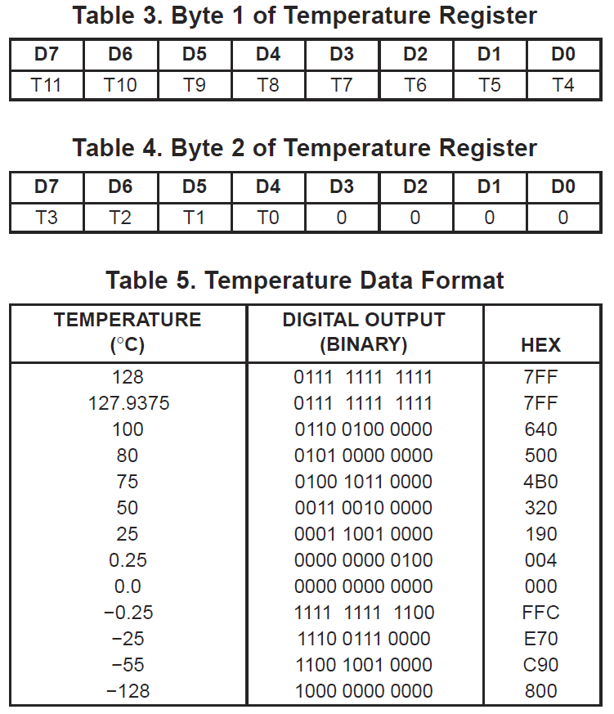
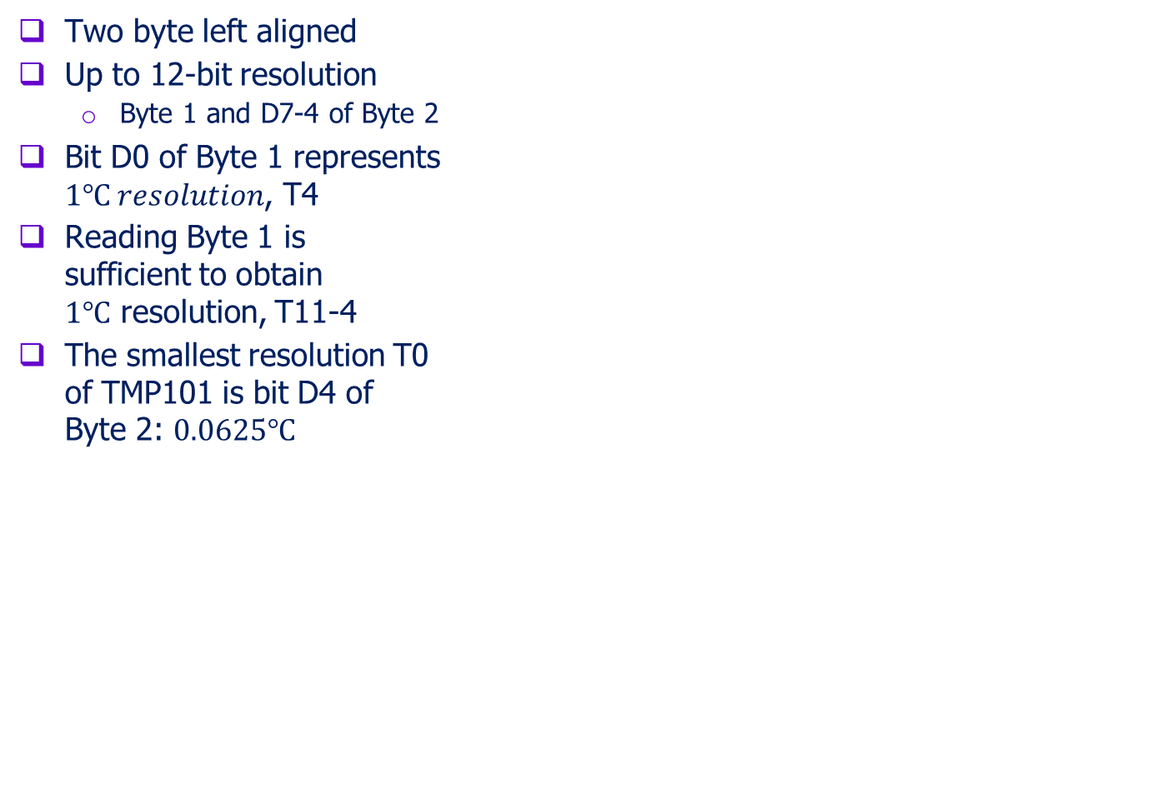
TMP101 Temperature Registers Byte 1 and Byte 2
Two byte left aligned
Up to 12-bit resolution
Byte 1 and D7-4 of Byte 2
Bit D0 of Byte 1 represents $1℃ resolution$, T4
Reading Byte 1 is sufficient to obtain $1℃$ resolution, T11-4
The smallest resolution T0 of TMP101 is bit D4 of Byte 2: $0.0625℃$

Slide 13
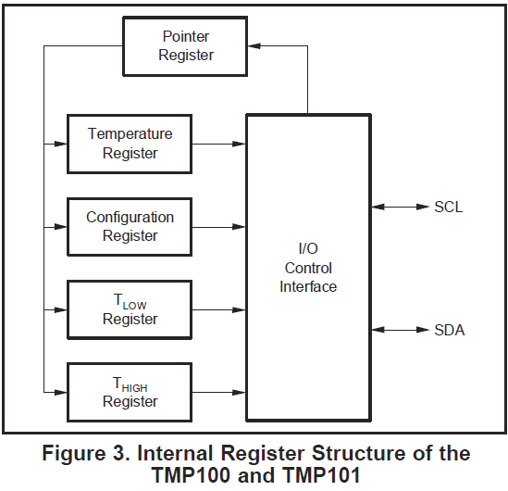
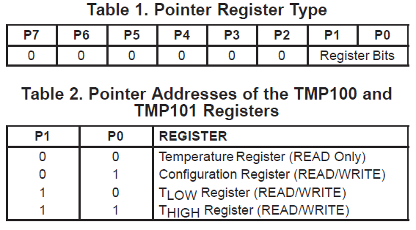
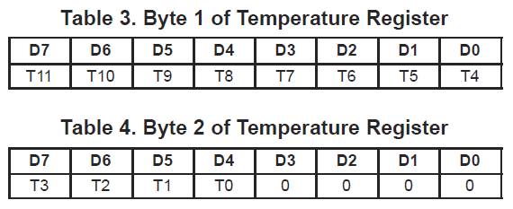
TMP101 Pointer Register
Pointer Register
Stores address of register to be accessed
Temperature
12 bits in two Bytes 1 and 2
Configuration
T_{LOW}
T_{HIGH}

Slide 14
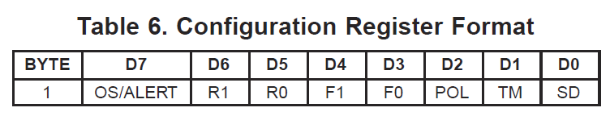
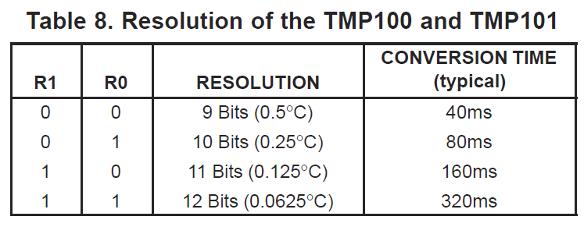
TMP101 Configuration Register
Configuration
OS/ALERT is Special event alert output
R1 and R0 are resolution bits to change speed and resolution
F1 and F0 are Fault Queue bits to set triggering tolerance
POL is Polarity of Alert Active Mode
TM is Thermostat Mode: comparator mode or interrupt mode
SD is Shut Down Mode to save power instead of continuous conversion
T_{LOW} and T_{HIGH} are two upper and lower limit registers

Slide 15
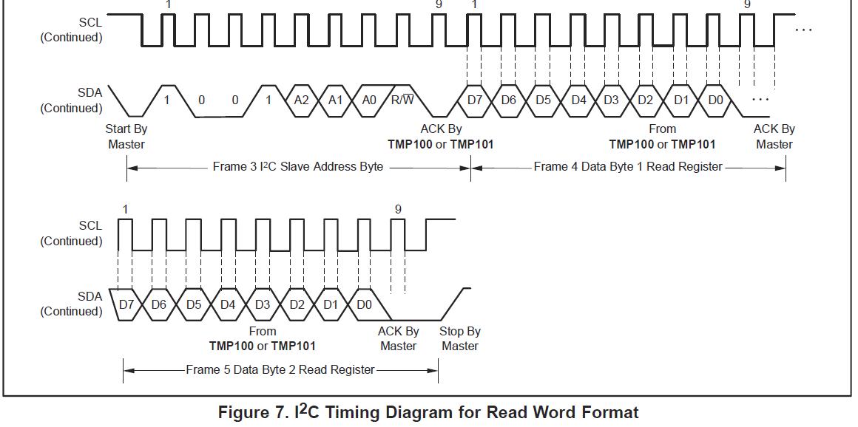
TMP101 Reading

Slide 16
I2C Command Sequence to Read TMP101 at 1001010
To read temperature
Start
0b10010101 //Send Device Address and Read Operation
ACK
Receive the higher byte of Temperature
ACK
Receive the lower byte of Temperature
ACK
Stop
To set pointer register
Start
0b10010100 //Send Device Address and Write Operation
ACK
0b00000011 //pointer register =2 for THIGH Register
ACK
Write to lower byte of THIGH Register
Write to higher byte of THIGH Register
Stop

Slide 17
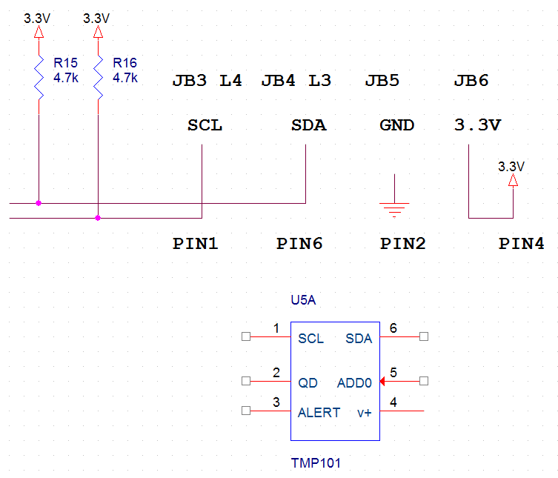
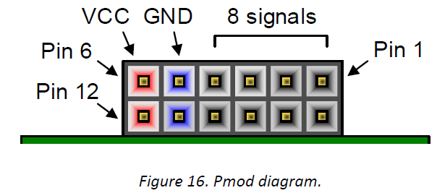
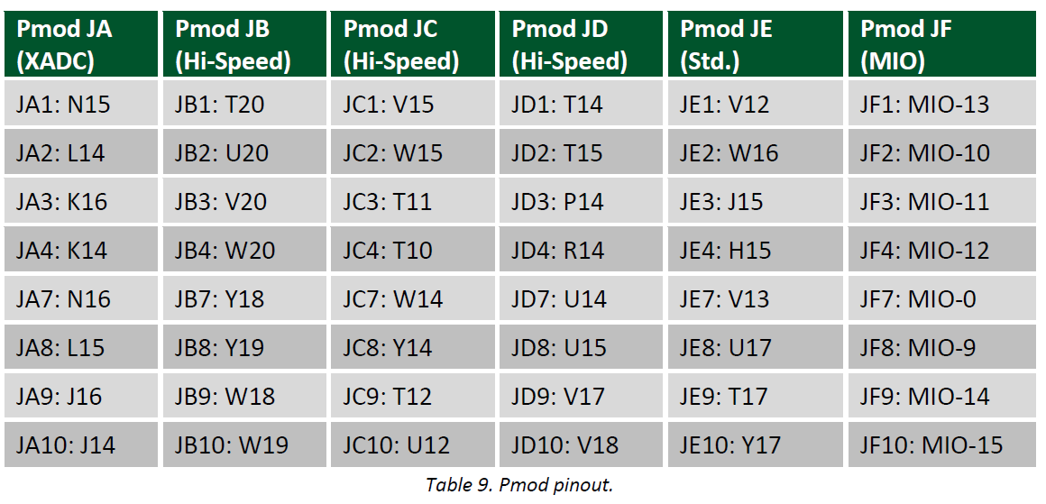
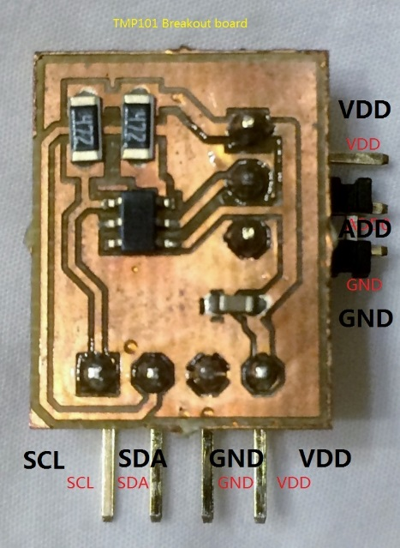
TMP101 Circuit Schematic
TMP101 is connected to JB connector
SCL to JD3 (pin P14)
SDA to JD4 (pin R14)
GND to JD5
V+ to JD6
VDD
AD0
GND

Slide 18

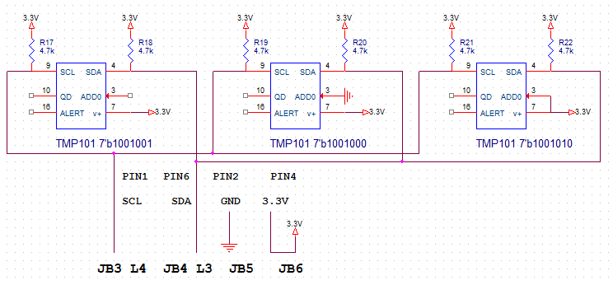
Connecting Three TMP101 Breakout Boards on I2C Bus
Breakout Board – SCL, SDA, GND, 3.3V
Three Addresses
7’b1001001 when ADD0 is floating
7’b1001000 when ADD0 is grounded
7’b1001010 when ADD0 is connected to power supply
VDD
AD0
GND

Slide 19
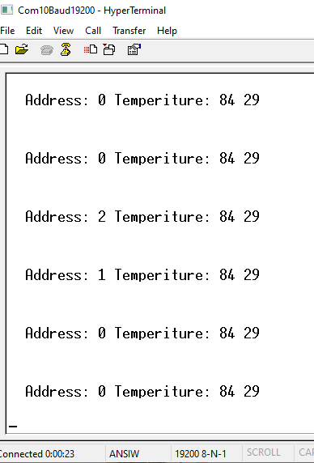
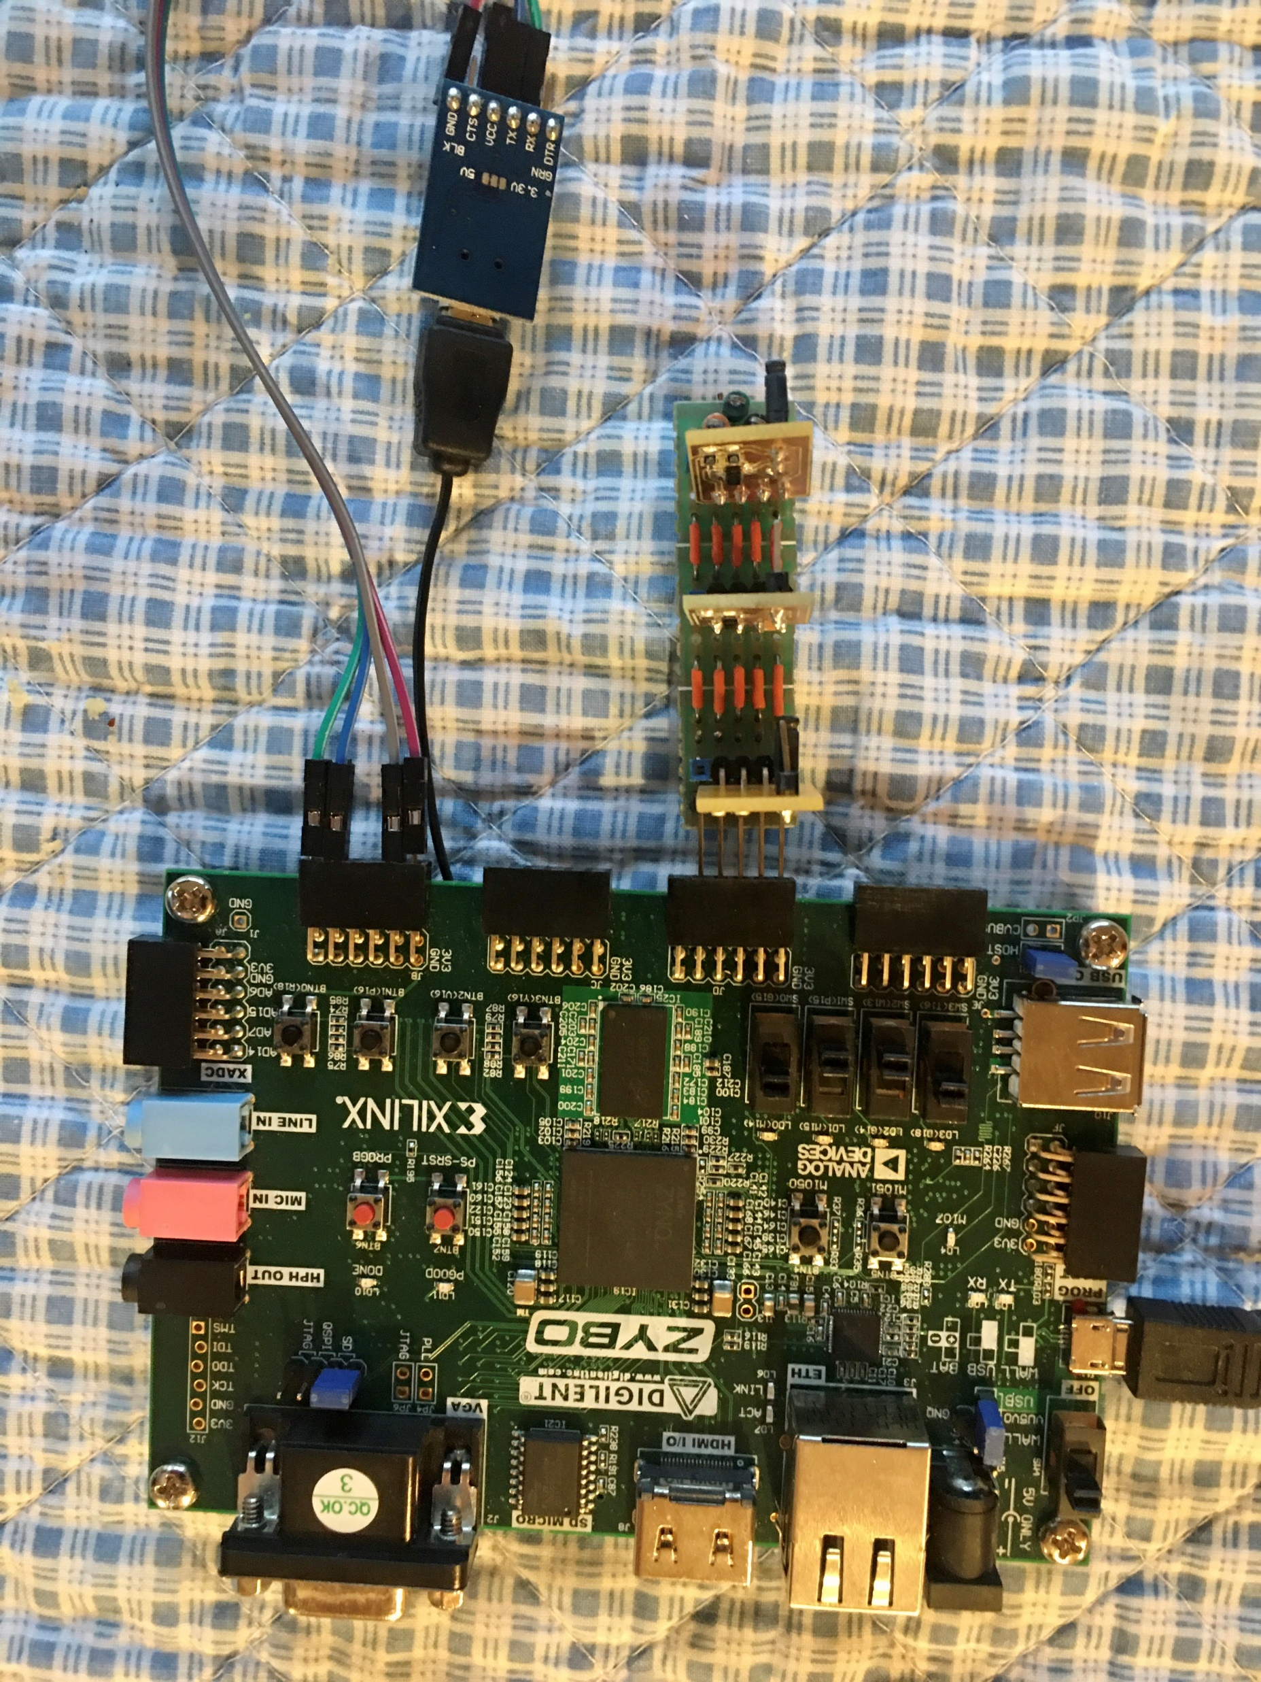
Three TMP101 Breakout Boards on Zybo Board
Lab #2 Phase II Final Circuit
To display temperature in Fahrenheit and Celsius from one TMP101 sensor
To switch between three TMP101 sensors that have different addresses by two slide switches
Display address and temperature in Celsius and Fahrenheit on a serial terminal

Slide 20
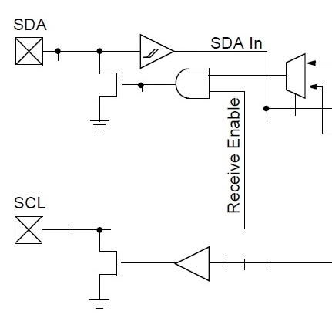
The Simplified I2C Module
15kHz
Baud Rate
Generator
Idle High
Data
Baud Clock
Write Load
ShiftorHold
8-bit Shift
Register
Baud Clock Enable
SDA
Tri-State
Bidirectional
Start
Stop
Acknowledge
Tri-state
Enable
1
0
ReadOrWrite
(0 to write)
Select
StartStopAck
SCL
Baud Clock
60MHz System Clock

Slide 21
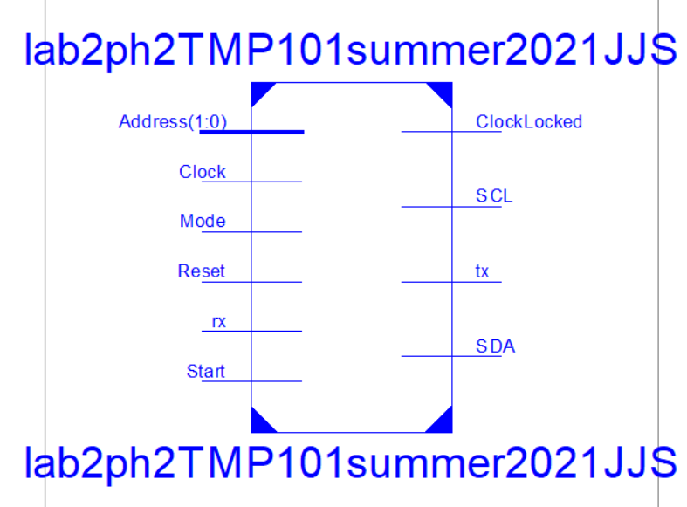
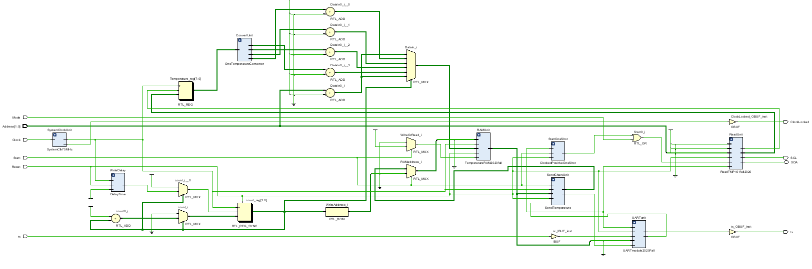
Lab #2 Phase II: Overall Circuit Implementation
Read TMP101 module: ReadTMP101summer2021
Temperature Conversion module: OneTemperatureConverter.v
UART to transmit RAM content

Slide 22
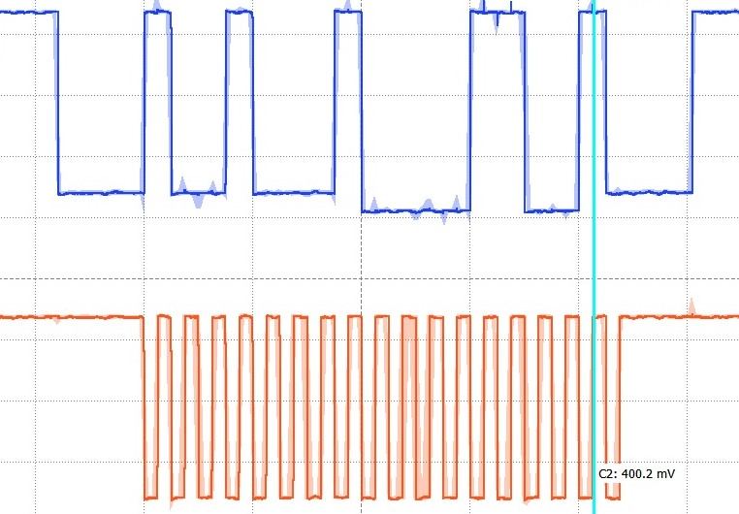
Controller Design Ideas
Start and Delay
Load
Send by shifting 8 times and counting on negative SCL edges
Receive Acknowledgement
Read by shifting 8 times and counting on positive SCL edges
Send acknowledgement
Delay and Stop

Slide 23
Controller Design Ideas: States and Outputs
When to start SCL, when to load data, when to shift for writing on negative ↓ SCL or reading on positive ↑ SCL
When to stop – wait for the last rising edge ↑
parameter InitialState=4'd0, StartState=4'd1, LoadState=4'd2, WriteState=4'd3, AcknowledgeState1=4'd4;
parameter ConnectedState=4'd5, ReadState=4'd6, WaitState=4'd7, AcknowledgeState2=4'd8;
parameter TransitState=4'd9, StopState=4'd10;

Slide 24
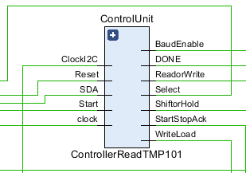
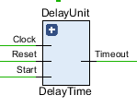
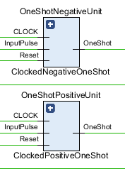
Controller Design Ideas: A Number of Interactive Circuits
A counter inside the controller to count the number of SCL cycles
Delay timer and positive and negative one-shot generators from SCL
Positive and negate one-shots from SCL
always@(posedge clock)
if(Reset==1) begin DataCounter<=4'd10; end else
case (State)
LoadState: if(OneShotNegative==1) DataCounter<=DataCounter-1'b1;
else DataCounter<=DataCounter;
WriteState: if(OneShotNegative==1) DataCounter<=DataCounter-1'b1;
else DataCounter<=DataCounter;
ReadState: if(OneShotPositive==1) DataCounter<=DataCounter-1'b1;
else DataCounter<=DataCounter;
default: DataCounter<=4'd10;
endcase

Slide 25
Lab #2 Phase II: Read Temp Module Controller ASM Chart (Ver 4.0)
Initial State
Start State
No
BaudRateEnable=0
ReadorWrite=0
Write Load=0
Select=0
ShiftorHold=0
StartStopAck=0
Count=10
StartTimer=Yes
BaudRateEnable=0
ReadorWrite=0
Write Load=0
Select=0
ShiftorHold=0
StartStopAck=1
Count=10
StartTimer=No
Low
TimeOut
High
SCL
Yes
Load Shift Reg
BaudRateEnable=1
ReadorWrite=0
WriteLoad=1
Select=0
ShiftorHold=0
StartStopAck=0
On SCL negedge: Count= Count-1
StartTimer=No
Write State
BaudRateEnable=1
ReadorWrite=0
Write Load=0
Select=1
ShiftorHold=NegativeSCLedge
StartStopAck=0
On SCL negedge: Count= Count-1
StartTimer=No
Yes
Start
No
Yes
No
Count decrements on negative edges of SCL clock for writing
Count==9
No
Yes
Stay in Load until SCL has started
Next page
Count==1
StartTimer=0 to start delay timer, i.e., No=1 and Yes=0

Slide 26
Lab #2 Phase II: Read Temp Controller ASM Chart (Ver 4.0) (page 2)
Count decrements on positive edges of SCL clock for reading
Read State
Acknowledge Write State
BaudRateEnable=1
ReadorWrite=1
Write Load=0
Select=1
ShiftorHold=Positive SCL Edge
StartStopAck=0
Done=0
On SCL posedge: Count= Count-1
StartTimer=No
No
Positive SCL Edge
Baud Rate Enable=1
ReadorWrite=1
Write Load=0
Select=0
ShiftorHold=0
StartStopAck=0
Count=10
Done=0
StartTimer=No
Yes
Check State
From
1st page
Check Acknowledgment
SDA==0
Yes
ReadorWrite=1 to read
Select=1 to choose shift register
Select=0 to choose Start, Stop and Ack
ShiftorHold=1 to shift
ShiftorHold=0 to hold
Done=0 StartTimer=0 to start delay timer
Count==2
No
No
Start State
Yes
To
3rd page
Count goes from 10 to 2 to read for 8 SCL clock. Read and Shift on shift register is on positive edges of SCL

Slide 27
Lab #2 Phase II: Read Temp Module Controller ASM Chart (Ver 4.0) (con’t)
Wait State
No
Transit State
Positive SCL Edge
Baud Rate Enable=0
ReadorWrite=0
Write Load=0
Select=0
ShiftorHold=0
StartStopAck=0
Count=10
Done=0
StartTimer=Yes
Baud Rate Enable=1
ReadorWrite=1
Write Load=0
Select=0
ShiftorHold=0
StartStopAck=1
Count=10
Done=0
StartTimer=No
From
2nd page
Yes
Check on rising edge of SCL
Baud Rate Enable=1
ReadorWrite=0
Write Load=0
Select=0
ShiftorHold=0
StartStopAck=0
Count=10
Done=0
StartTimer=No
No
Yes
TimeOut
No
Negative SCL Edge
Yes
Stop State
ReadorWrite=1 to read
Select=1 to choose shift register
Select=0 to choose Start, Stop and Ack
ShiftorHold=1 to shift
ShiftorHold=0 to hold
Done=1, No=1, Yes=0
Acknowledge Read State
Baud Rate Enable=0
ReadorWrite=0
Write Load=0
Select=0
ShiftorHold=0
StartStopAck=1
Count=10
Done=1
StartTimer=Yes
No
TimeOut
Yes
Initial State

Slide 28
Lab #2 Phase II: Count Update State Machine
Reset
Default State
Write State
Read State
Count=10
Count=10
Count= Count
Count= Count
Load State
SCL negative edge
SCL positive edge
Count= Count
No
No
Yes
Yes
Count= Count-1
Count= Count-1
SCL negative edge
No
always@(posedge clock)
if(Reset==1) begin DataCounter<=4'd10; end else
case (State)
LoadState: if(OneShotNegative==1) DataCounter<=DataCounter-1'b1; else DataCounter<=DataCounter;
WriteState: if(OneShotNegative==1) DataCounter<=DataCounter-1'b1; else DataCounter<=DataCounter;
ReadState: if(OneShotPositive==1) DataCounter<=DataCounter-1'b1; else DataCounter<=DataCounter;
default: DataCounter<=4'd10;
endcase
Yes
Count= Count-1

Slide 29
Lab #2 Phase II: Delay Time Module
Reset
module DelayTime(input Reset, Clock, Start, output reg Timeout);
//for simulation
//parameter MaxCount = 3;
//for board implementation
parameter MaxCount = 10000;
parameter NumberOfBits = 20;
reg [NumberOfBits-1:0] count;
always @ (count)
if(count==MaxCount) Timeout<=1;
else Timeout<=0;
always @ (posedge Clock)
if(Reset==1) count<=0; else
if(Start==1) begin count <= 0; end
else if (count>=MaxCount) count<=0;
else count <= count+1'b1;
endmodule
Count=0
TimeOut=0
Wait State
Count=0
TimeOut t=0
No
StartTimer=1
Yes
Count-Up State
Count= Count-1
TimeOut =0
No
Count=Max
Timeout State
Yes
Count=0
TimeOut =1

Slide 30
Lab #2 Phase II: SCL One Shots, Count Update, ACK Bit
wire OneShotNegative, OneShotPositive;
ClockedNegativeOneShot OneShotNegativeUnit(ClockI2C, OneShotNegative, Reset, clock);
ClockedPositiveOneShot OneShotPositiveUnit(ClockI2C, OneShotPositive, Reset, clock);
reg ACKbit;
always@(posedge clock)
if(Reset==1) begin State<=InitialState; ACKbit<=1; end
else begin State<=NextState;
if(OneShotPositive==1) ACKbit<=SDA; else ACKbit<=ACKbit; end
//count update, negative SCL edge to write and positive SCL edge to read
always@(posedge clock)
if(Reset==1) begin DataCounter<=4'd10; end
else
case (State)
LoadState: if(OneShotNegative==1) DataCounter<=DataCounter-1'b1; else DataCounter<=DataCounter;
WriteState: if(OneShotNegative==1) DataCounter<=DataCounter-1'b1; else DataCounter<=DataCounter;
ReadState: if(OneShotPositive==1) DataCounter<=DataCounter-1'b1; else DataCounter<=DataCounter;
default: DataCounter<=4’d10;
endcase

Slide 31
Lab #2 Phase II: ControllerReadTMP101.v Simulation Test Bench
`timescale 1ns / 1ps
//set MaxCount =3 for simulation in module DelayTime()
//parameter MaxCount = 3;
module ControllerReadTMP101_tb;
reg Go, SDA, Reset, ClockI2C, clock;
wire WriteLoad, ReadorWrite, ShiftorHold, Select, BaudEnable, StartStopAck,DONE;
wire [3:0] State=uut.State;
wire [3:0] DataCounter=uut.DataCounter;
wire TimeOut=uut.TimeOut, ACKbit=uut.ACKbit;
wire OneShotPositive=uut.OneShotPositive, OneShotNegative=uut.OneShotNegative;
ControllerReadTMP101 uut (Reset, clock, Go, ClockI2C, SDA, WriteLoad, ReadorWrite, ShiftorHold, Select, BaudEnable, StartStopAck, DONE);
initial begin Go = 0; Reset = 0; ClockI2C = 0; clock = 0; end
always #4 clock=~clock;
always #12 ClockI2C=~ClockI2C;
initial fork
#0 Go = 0; #12 Go = 1;
#0 Reset = 1; #6 Reset = 0;
#0 SDA=0; #13 SDA=1; #25 SDA=0; #56 SDA=1; #134 SDA=0; #189 SDA=1;
#300 SDA=0; #900 $stop;
join
endmodule

Slide 32
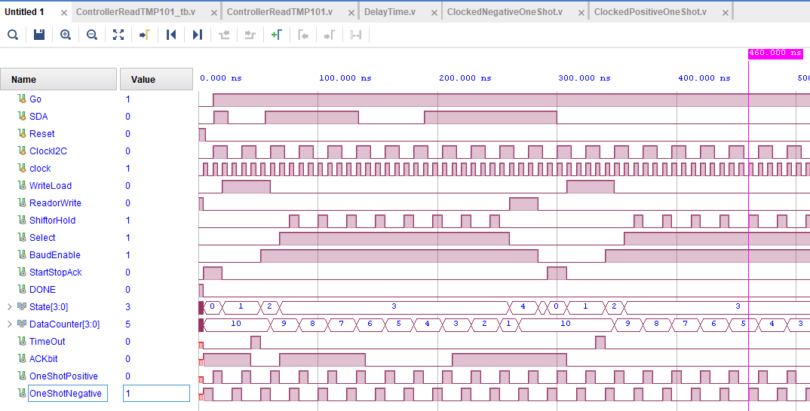
ControllerReadTMP101.v Simulation (Page 1 of 2)
Time delay = 3 in DelayLoop.v of ControllerReadTempI2C.v

Slide 33
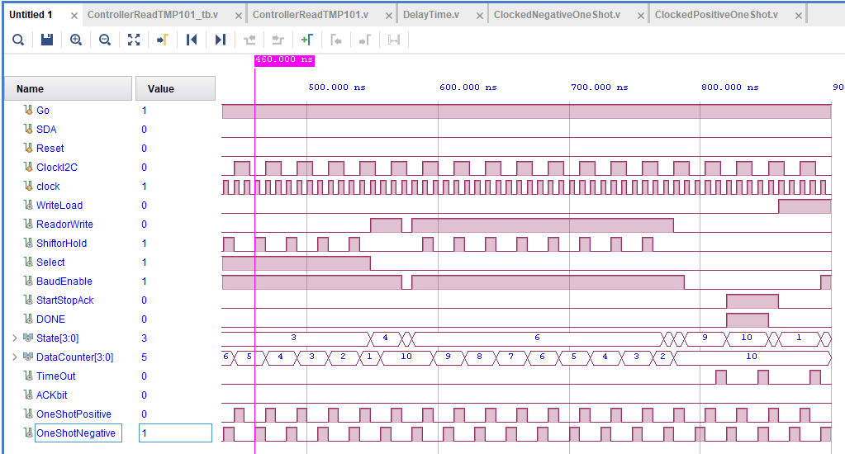
ControllerReadTMP101 .v Simulation (Page 2 of 2)
Time delay = 3 in DelayTime.v of ControllerReadTempI2C.v

Slide 34
Lab #2 Phase II: ControllerReadTMP101.v (Incomplete Module)
module ControllerReadTMP101 (input Reset, clock, Start, ClockI2C, SDA,
output reg WriteLoad, ReadorWrite, ShiftorHold, Select, BaudEnable,
output reg StartStopAck, DONE);
parameter InitialState=4'd0, StartState=4'd1, LoadState=4'd2, WriteState=4'd3, AcknowledgeState1=4'd4;
parameter ConnectedState=4'd5, ReadState=4'd6, WaitState=4'd7, AcknowledgeState2=4'd8;
parameter TransitState=4'd9, StopState=4'd10;
reg [3:0] DataCounter; reg [3:0] State, NextState;
wire TimeOut; reg StartDelayLoop;
DelayTime DelayUnit(Reset, clock, StartDelayLoop,TimeOut);
wire OneShotNegative, OneShotPositive;
ClockedNegativeOneShot OneShotNegativeUnit(ClockI2C, OneShotNegative, Reset, clock);
ClockedPositiveOneShot OneShotPositiveUnit(ClockI2C, OneShotPositive, Reset, clock);
reg ACKbit;
always@(posedge clock)
if(Reset==1) begin State<=InitialState; ACKbit<=1; end
else begin State<=NextState; if(OneShotPositive==1) ACKbit<=SDA; else ACKbit<=ACKbit; end
//Next state transition block
//Count update
//Output block
endmodule

Slide 35
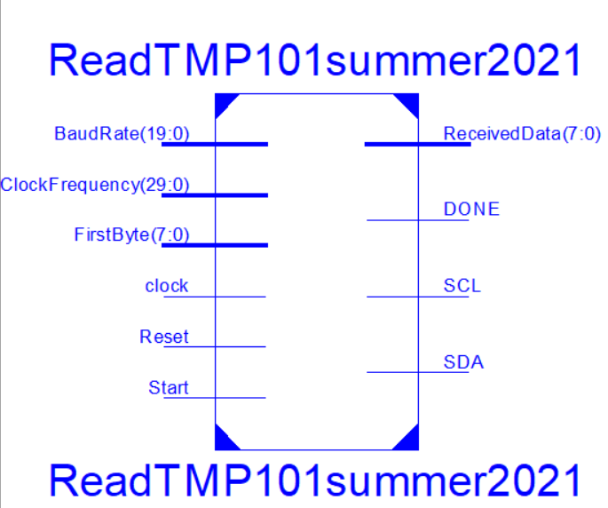
Lab #7 Phase II: ReadTMP101summer2021 to Read One Temp Sensor
I2C_BaudRateGeneraor.v and I2C_DataUnit.v are from Phase 1
ControllerReadTMP101.v is based on Phase 1 Controller
module ReadTMP101summer2021(input Reset, clock, Start,
input [7:0] FirstByte, input [19:0] BaudRate,
input [29:0] ClockFrequency,
output DONE, SCL,
inout SDA, output [7:0] ReceivedData);
wire WriteLoad, ReadorWrite, ShiftorHold, Select, BaudEnable, StartStopAck;
I2C_BaudRateGenerator BaudRateUnit(Reset, clock, BaudEnable, BaudRate, ClockFrequency, SCL);
ControllerReadTMP101 ControlUnit(Reset, clock, Start, SCL, SDA, WriteLoad, ReadorWrite,
ShiftorHold, Select, BaudEnable, StartStopAck, DONE);
I2C_DataUnit DataUnit(Reset, clock, WriteLoad, ReadorWrite, ShiftorHold, Select, StartStopAck,
FirstByte, ReceivedData, SDA);
endmodule

Slide 36
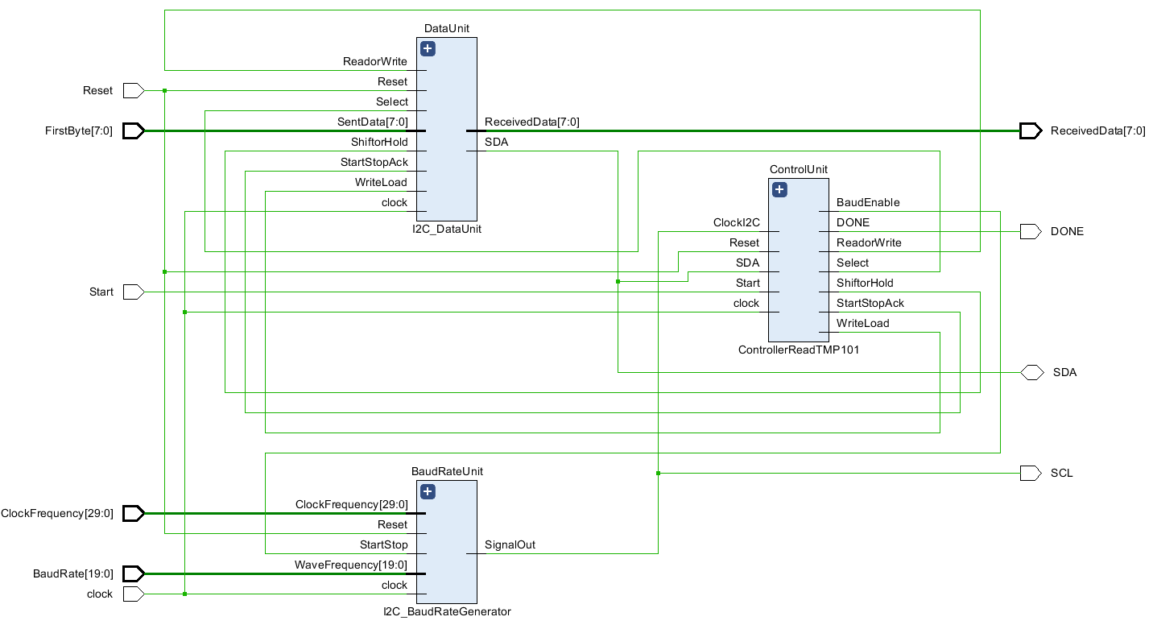

Slide 37
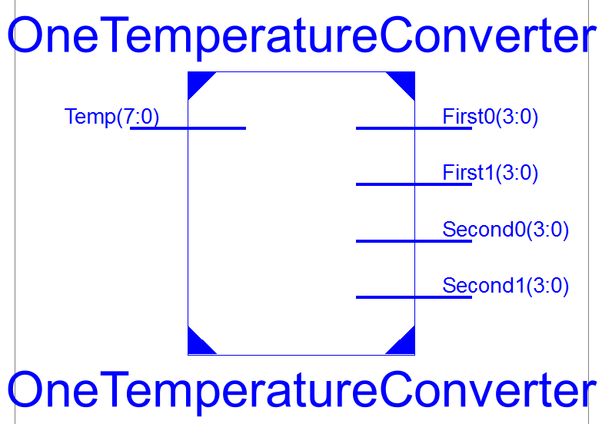
Temperature Conversion Circuits
module OneTemperatureConverter(Temp, First1, First0, Second1, Second0);
input [7:0] Temp;
output [3:0] First1, First0, Second1, Second0;
wire [15:0] LongTemp=Temp;
assign First1 = (LongTemp*8'd18/'d10+8'd32)/8'd10;
assign First0 = (LongTemp*8'd18/8'd10+8'd32)%8'd10;
assign Second1 = Temp/8'd10;
assign Second0 = Temp%8'd10;
endmodule

Slide 38
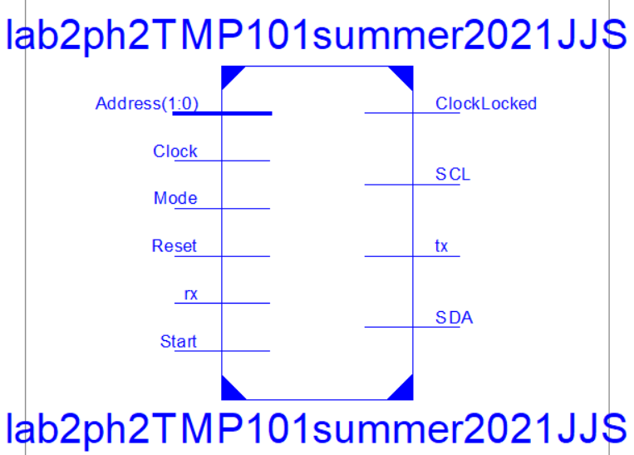
Lab #2 Phase II: Top-Level
Mode is a slide button to choose one shot or continuous
Start is a push button to read temperature once each time it is pressed, i.e., one shot mode.
Select an address from two slide switches
Address from 0 to 2 and its associated temperature is displayed in both Celsius and Fahrenheit on a serial port terminal

Slide 39
module lab2ph2TMP101summer2021JJS (input Reset, Clock, rx, Mode, Start, input [1:0] Address,
output tx, SCL, ClockLocked, inout SDA);
parameter I2CBaudRate=20’d15000, ClockFrequency=30’d60000000;
parameter RAMAddressSize=7;
wire clock75MHz;
SystemClk75MHz SystemClockUnit(.clk_in125MHz(Clock),.clk_out75MHz(clock75MHz), .locked(ClockLocked));
ReadTMP101summer2021 ReadUnit(Reset, clock75MHz, StartReading||Mode, Chip, I2CBaudRate, ClockFrequency,
DONE, SCL, SDA, ReceivedData);
wire [3:0] Fahtenth, Fahones, Celtenth, Celones;
reg [7:0] Temperature;
always@(posedge clock75MHz) if(DONE==1) Temperature<=ReceivedData; else Temperature<=Temperature;
OneTemperatureConverter ConvertUnit(Temperature, Fahtenth, Fahones, Celtenth, Celones);
TemperatureRAM2021summer RAMUnit(Reset, clock75MHz, WriteOrRead, RAMaddress, DataIn, RAMDataout);
assign tx_data={1'b0,RAMDataout};
SendTemperature SendCharsUnit(Start, tx_full, Reset, clock75MHz, RAMDataout, write_to_uart, Transmitting, ReadAdress);
UARTmodule2021summer UARTunit(Reset, clock75MHz, read_from_uart, write_to_uart, rx, tx_data, tx_full, rx_data_present,
tx, rx_data, );
endmodule

Slide 40
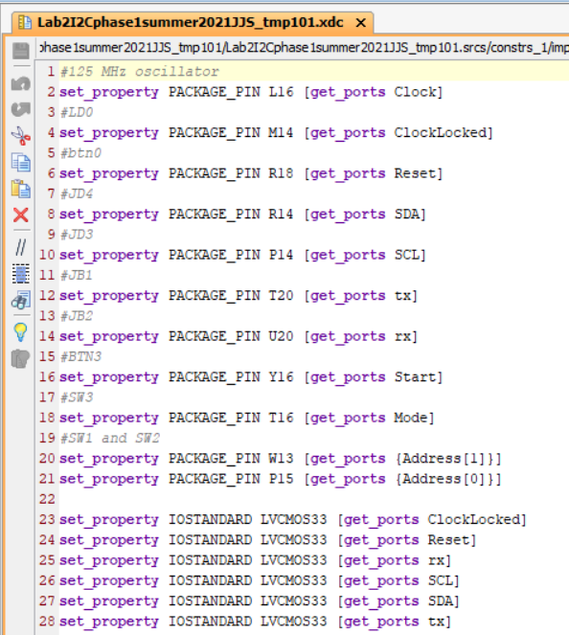

Slide 41
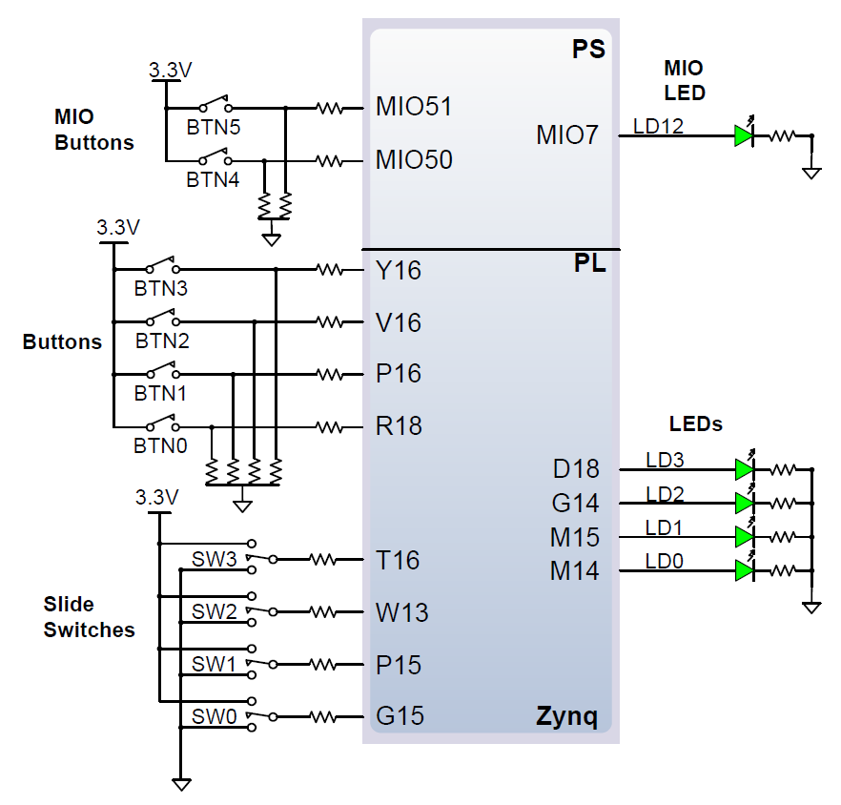

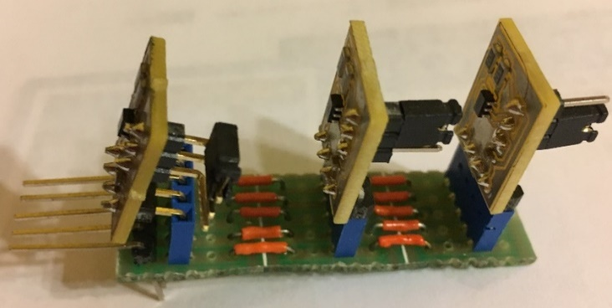

Slide 42
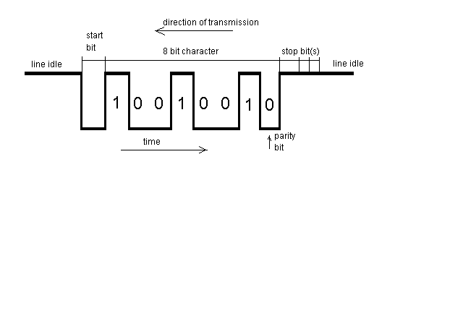
Asynchronous Serial Data Transmission
A frame
Start bit, data bits, parity, stop bit
Bit Rate (Baud Rate) - #bits/second
Idle State – Logic “1”
Parity
Odd parity – sum of “1” including parity bit is an odd number
Even parity – sum of “1” including parity bit is an even number
Notes:
Mark State is “1” and Space State is “0”.
One frame consists of one start bit, 8 or 9 data bits, 1 parity bit, and 1 or 2 stop bits. Start bit is a Space and stop bits are Marks.
Idle State is one frame of Marks. Break State is one frame of Spaces.
Bit rate is the number of bits transmitted in one second. Baud rate is the number of signaling units per second when the bits are modulated. In digital data communication, bit and baud rates are exchangeable.
A parity of a word can be either even or odd and is determined by the number of “1”s it contains. For example, 10101111 and 11001100 have even parity, and 11010101 and 11001101 have odd parity. Parity error can be checked with exclusive or operation of all bits: parity error occurs if the result is “1” for even parity or “0” for odd parity, indicating an odd number of “1”s are in error.

Slide 43
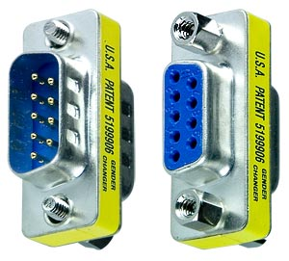
Transmission Rates: Baud Rate and Bits per second
Baud rate
measures number of signal changes per second
Bits per second
measures number of bits transmitted per second
In RS-232, baud rate == bits per second
each signal change represents one bit, so baud rate and bits per second are equal
If each signal change represents more than one bit, bits per second may be greater than baud rate
This is not a clock signal, but a control or timing signal.

Slide 44
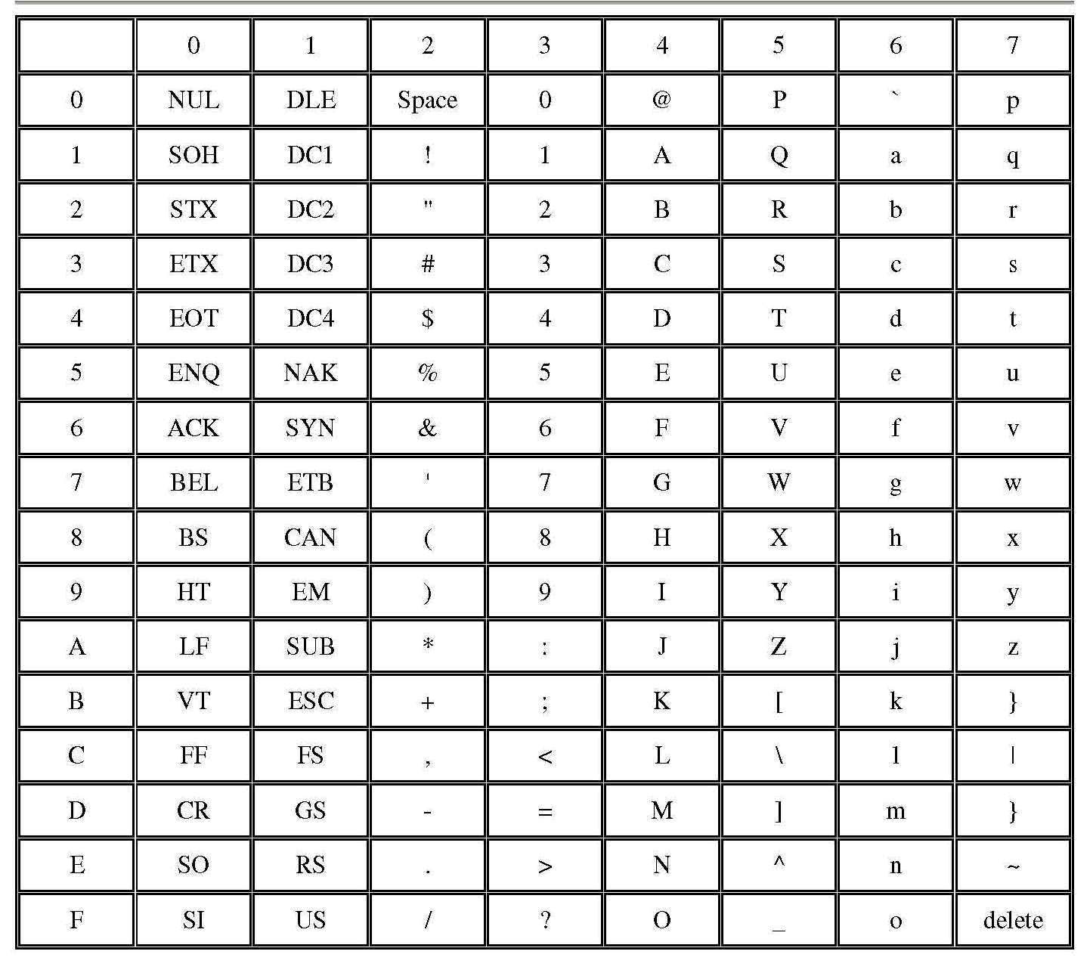
ASCII 7-Bit Code (American Standard Code for Information Interchange)
higher nibble
Lower nibble

Slide 45




RS-232 DB-9 Connectors
Only three pins on a DB9 connector
Pin 2 – Tx, N18 on Spartan 6
Pin 3 – Rx , N17 on Spartan 6
Pin 5 – GND, 0V voltage reference

Slide 46




uart_clock.v

Slide 47

Receive and transmit modules, Baud Rate Generator
Baud rate is generated by an always block
Data transmit is done by uart_tx.v
Data receive is done by uart_rx.v
uart_tx module
Baud Rate Circuit
uart_rx module

Slide 48

A New Portable Baud Rate Generator Module
//File Name: BaudRateGenerator.v
//Inputs: Baud Rate in BaudRate, System Clock Frequency in ClockFrequency
//Output: uartClock, a clock that is 16 times faster than the uart bit speed
module BaudRateGenerator (uartClock, Reset, clock, BaudRate, ClockFrequency);
input Reset, clock;
input [19:0] BaudRate; //up to 1,000,000
input [29:0] ClockFrequency; //up to 1GHz
output reg uartClock;
reg [15:0] baud_count;
always @(posedge clock)
if(Reset==1) begin baud_count <= 1'b0;
uartClock <= 1'b1; end
else if (baud_count == ClockFrequency/(BaudRate*16))
begin
baud_count <= 1'b0;
uartClock <= 1'b1; end
else begin
baud_count <= baud_count + 1'b1;
uartClock <= 1'b0; end
endmodule

Slide 49
The New Baud Rate Generator Module Simulation
A one-shot pulse is generated after every 6 clock cycles
This is a control signal, not a clock.
Assume clock=1600, baud rate=20, then baud count =5;
6 clock Cycles

Slide 50

uart_tx Module from Xilinx University Program
data_in contain a byte to be transmitted.
buffer_full is 1 if the transmit buffer is full.
write_buffer is 1 to write data_in into the buffer. It must be a one-shot.
en_16_x_baud is the transmit and receive clock, 16x faster than baud rate
// /___/ \ / Vendor: Xilinx
// \ \ \/ Version: 2.10
// \ \ Filename: uart_tx.v
// / / Date Last Modified: March 19 2010
// /___/ /\ Date Created: October 14 2002
// Device: Xilinx
// Purpose: UART Transmitter with integral 16 byte FIFO buffer
// 8 bit, no parity, 1 stop bit
module uart_tx (
input [7:0] data_in,
input write_buffer,
input reset_buffer,
input en_16_x_baud,
output serial_out,
output buffer_full,
output buffer_half_full,
input clk);

Slide 51

uart_tx.v is composed of transmit and FIFO buffer modules
kcuart_tx is transmit module
Bbfifo_16x8.v is 16x8 FIFO buffer
write_buffer==1 to write an 8-bit data into the FIFO buffer,
This needs to be a one-shot
buffer_full==1 if buffer is full
Transmit will start and continue if buffer is not empty, i.e., data_present==1
kcurat_tx is the transmit module
bbfifo_16x8 is a 16-level 8-bit first-in-first-out buffer

Slide 52

Transmit Module uart_tx .v (created in 2002, revised in 2010)
kcuart_tx.v
Bbififo_16x8.v

Slide 53

bbfifo_16x8 Module from Xilinx University Program
16 stage deep 8-bit first in and first out (FIFO) buffer
This is a bad example of what not to do to create a Verilog circuit although it might have been written to be optimized for Xilinx FPGA
module bbfifo_16x8(
input [7:0] data_in,
output [7:0] data_out,
input reset,
input write,
input read,
output full,
output half_full,
output data_present,
input clk);

Slide 54

bbfifo_16x8 Module from Xilinx University Program
This circuit has many magic numbers and not well organized
The module is customized or optimized for Xilinx FPGA and therefore is not easily portable

Slide 55


kcuart_tx module (created in 2002, revised in 2010)
This module is also impossible to port.
It has many random numbers and written at a low level of RTL
Send 8-bit data at data_in to serial_out bit by bit
Send_character=1 to send
Tx_complete=1 when complete
module kcuart_tx (
input [7:0] data_in,
input send_character,
input en_16_x_baud,
output serial_out,
output Tx_complete,
input clk );

Slide 56


Receive Module uart_rx.v
uart receiver also has a 16-level buffer to store incoming data
There are two submodules
Kcuart_rx.v, bbfifo_16x8.v
Buffer_full=1 when buffer is full
Buffer_data_present=1 when there is new data
read_buffer is “1” (one shot) to read one byte from 8-bit data_out

Slide 57

UARTmodule2021summer.v for Both Transmit and Receive
To send a byte
Check if tx_full==0, i.e., transmit buffer is not full
place the byte on tx_data bus, pulse write_to_uart (one shot)
to receive a byte
Check if rx_data_present==1, pulse read_from_uart (one shot) for new data
The byte is available on rx_data bus

Slide 58


uartTyperwriter2021summer.v
Type on a serial port terminal

Slide 59
module UartTyperwriter2021summer(input clock, reset, rx, output tx, output [3:0] transmitted_bits);
reg read_from_uart, write_to_uart;
wire tx_full, tx_half_full, rx_data_present, rx_full, rx_half_full;
wire [7:0] rx_data, tx_data;
reg [7:0] databuffer;
reg newdata; //new data flag
always@(posedge clock) begin
if(reset==1) begin read_from_uart<=0; newdata<=0; databuffer<=0; end
else if (rx_data_present==1) begin read_from_uart<=1; newdata<=1; databuffer<=rx_data; end
else begin read_from_uart<=0; newdata<=0; databuffer<=0; end
if(reset==1) begin write_to_uart<=0; end
else if (newdata==1) begin write_to_uart<=1; end
else begin write_to_uart<=0; end
end
UARTmodule2021summer UARTunit(reset, clock, read_from_uart, write_to_uart, rx, databuffer, tx_full, rx_data_present,
tx, rx_data, transmitted_bits);
endmodule

Slide 60

RAM Definition in Verilog
RAM – random access memory, a data item at an address can be read or written at the run time.
RAM can be defined in Verilog to store and update data. In the following example, the content at each location is 8 bits long. The number of locations is defined as the number of address bits, AddressBits, which is 5. Up to 2⁵=32 locations of 8 bits each can be accessed.
A control signal WriteOrRead sets up the RAM for reading or writing (WriteOrRead==1 to write.
In reading mode, content at location Address is shown at OurtputValue,
In writing mode, content at InputValue is stored at Address

Slide 61
RAM Definition and Initialization in Verilog
Syntax
Reg [word_length-1:0] RAM_Name [0:Address_Length-1];
ReadRAM=RAM_Name[address]; //read RAM
RAM_Name[address]=content; //write to RAM
module RAM21x7bits #(parameter DataLength=7, AddressBits=5, MemorySize=21)(
input ReadOrWrite, Clock, Reset,
input [DataLength-1:0] InputValue,
input [AddressBits-1:0] Address,
output reg [DataLength-1:0] OutputValue);
//RAM of 21 addresses of 7 bits at each address
reg [DataLength-1:0] ASCIICode [0:MemorySize-1];

Slide 62
`timescale 1ns / 1ps
module RAM21x7bits #(parameter DataLength=7, AddressBits=5, MemorySize=21)(
input ReadOrWrite, Clock, Reset,
input [DataLength-1:0] InputValue,
input [AddressBits-1:0] Address,
output reg [DataLength-1:0] OutputValue);
//RAM of 21 addresses of 7 bits at each address
reg [DataLength-1:0] ASCIICode [0:MemorySize-1];
always@(posedge Clock or posedge Reset)
if(Reset==1) begin
ASCIICode[0]<="E"; ASCIICode[1]<="C"; ASCIICode[2]<="E"; ASCIICode[3]<="4";
ASCIICode[4]<="3"; ASCIICode[5]<="3"; ASCIICode[6]<=" "; ASCIICode[7]<="F";
ASCIICode[8]<="a"; ASCIICode[9]<="l"; ASCIICode[10]<="l"; ASCIICode[11]<=" ";
ASCIICode[12]<=" "; ASCIICode[13]<="2"; ASCIICode[14]<="0"; ASCIICode[15]<="2";
ASCIICode[16]<="0";
ASCIICode[17]<=8'h0A; //line feed
ASCIICode[18]<=8'h0D; //carriage return
ASCIICode[19]<=8'h0A; //line feed
ASCIICode[20]<=“NULL ";
end
else if (ReadOrWrite==1) begin //read memory
OutputValue<=ASCIICode[Address];
end
else begin
ASCIICode[Address]<=InputValue;
end
endmodule

Slide 63

Transmit Example: Sending Content of RAM to UART
40MHz Clock generator – a module from IP library
uart_tx – a module from Xilinx University Program
Baud rate generator
Inputs: clock frequency and baud rate
Output: clock with frequency of (baud rate) x16
RAM module – 8 bits by 30 locations
Overall controller
Inputs: transmit buffer full flag, (baud rate) x16-clock
Outputs: current address, write to transmit FIFO buffer pulse

Slide 64
TransmitRAM2021summer.v
module TransmitRAM2021summer(input clock, reset, rx, output tx, lock);
wire clk40MHz;
//clock module
ClockGenerator40MHz ClockUnit50MHz(.clock_in(clock),.clk40MHz(clk40MHz),.locked(lock));
//Baud Rate Generator
parameter BAUDRATE=20'd19200, FREQUENCY=30'd40000000;
wire en_16_x_baud;
BaudRateGenerator BaudRateUnit(en_16_x_baud, reset, clk40MHz, BAUDRATE, FREQUENCY);
// Signals for UART connections
wire write_to_uart, tx_full, tx_half_full;
reg read_from_uart;
wire [7:0] rx_data;
wire rx_data_present, rx_full, rx_half_full;
wire [7:0] out_port;
uart_tx TransmitUnit( .data_in({1’b0, RAM_dataout}), .write_buffer(write_to_uart), .reset_buffer(1'b0), .en_16_x_baud(en_16_x_baud), .serial_out(tx),.buffer_full(tx_full), .buffer_half_full(),.clk(clk40MHz));
//RAM
parameter DataLength=8;
wire [DataLength-1:0] OutputValue;
parameter AddressBits=5;
wire [AddressBits-1:0] Address;
wire [6:0] RAM_dataout;
//RAM
RAM21x7bits RAMUnit(1'b1, clk40MHz, reset, , Address, RAM_dataout);
assign start=1'b1;
OverallController ControlUnit(tx_full, en_16_x_baud, clk40MHz,
reset, start, write_to_uart, Address);
endmodule

Slide 65
The Overall Controller
Reset
Initial
InitialState=0
write_to_uart<=0; Address<=0
No
Start
Yes
WaitState=1
Wait
Yes
write_to_uart<=0; Address<=0
Address==#Chars
Yes
No
Tx_full
No
Transmit
TransmitState=2
0
en_16_x_baud
write_to_uart<=1; if(Address!=#chars) Address<=+1 else Address=0
1
Baud Clock
One-Shot

Slide 66
The Overall Controller
module OverallController #(parameter AddressBits=5, NumberOfLines=21) (
input tx_full, en_16_x_baud, clk, reset, start,
output reg write_to_uart, output reg[AddressBits-1:0] Address);
parameter initialState=2'd0, waitState=2'd1, transmitState=2'd2;
reg [1:0] state;
//state transitions
always@(posedge clk) begin
if(reset==1) state<=initialState;else
case (state)
initialState: if(start==0) state<=initialState; else state<=waitState;
waitState: if (tx_full==0 && en_16_x_baud==1) state<=transmitState; else state<=waitState;
transmitState: if (Address==NumberOfLines) state<=initialState; else state<=waitState;
default: state<=initialState;
endcase
end
//output
always@(posedge clk)
case (state)
initialState: begin write_to_uart<=0; Address<=0; end
waitState: begin write_to_uart<=0; Address<=Address; end
transmitState: begin write_to_uart<=1;
if(Address==NumberOfLines) Address<=0; else Address<=Address+1'b1; end //generate a one shot
default: begin write_to_uart<=0; Address<=0; end
endcase
endmodule

Slide 67

`timescale 1ns / 1ps
module OverallController_tb;
reg tx_full, en_16_x_baud, clk, reset, start;
wire write_to_uart; wire [4:0] Address;
OverallController uut (tx_full, en_16_x_baud, clk, reset, start, write_to_uart, Address);
initial begin clk = 0; end
initial fork
#0 start=0; #33 start=1; #43 start=0; #76 start=1; #128 start=0; #153 start=1;
#0 reset = 1; #8 reset=0;
#0 tx_full = 0; #100 tx_full=1; #150 tx_full=0;
#0 en_16_x_baud=0; #24 en_16_x_baud=1; #28 en_16_x_baud=0;
#44 en_16_x_baud=1; #48 en_16_x_baud=0; #64 en_16_x_baud=1; #68 en_16_x_baud=0;
#84 en_16_x_baud=1; #88 en_16_x_baud=0; #104 en_16_x_baud=1; #108 en_16_x_baud=0;
#134 en_16_x_baud=1; #138 en_16_x_baud=0; #154 en_16_x_baud=1; #158 en_16_x_baud=0;
#184 en_16_x_baud=1; #188 en_16_x_baud=0;
#240 $stop;
join
always #2 clk = ~clk;
endmodule

